Slide 1
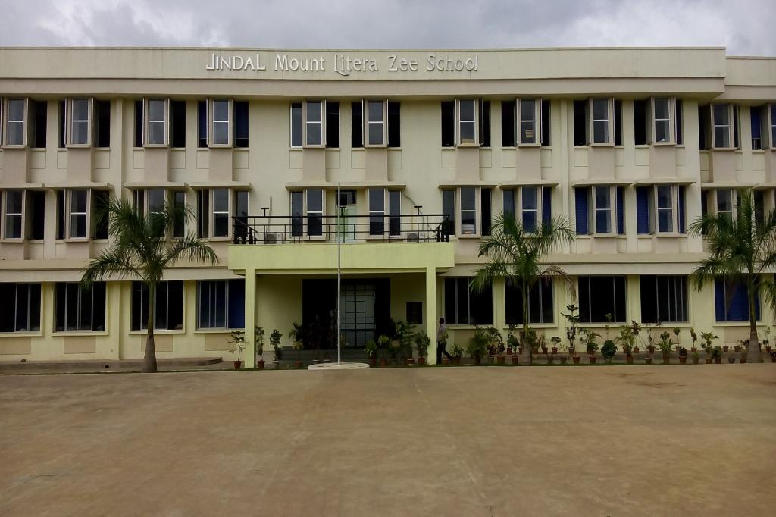
A Warm Welcome to all Parents and Guests!!
2021-22

Slide 3
The Vision/Mission of JMLZS
Mount Litera Zee School will provide a complete and unique educational experience for the child, preparing him/her for a successful life in the contemporary society.
The vision of Mount Litera Zee School envisages:
To create an excellent educational institution synthesizing the human values with the highest quality of teaching–learning using modern technology-driven tools for preparing a well-rounded personality for our society.
To make children aware of the significance of an eco-friendly environment. To nurture the unique potential in each child.
© Jindal Mount Litera Zee School, Sukeli.

Slide 4
Our Philosophy
At the core of every thing we do at Mount Litera Zee School is one simple principle. What’s Right For the Child (WRFC). Through that mantra we filter all our decisions and actions. WRFC helps us keep the child at the center of everything we do and ensures single-minded devotion to his/her growth and development.
© Jindal Mount Litera Zee School, Sukeli.

Slide 5
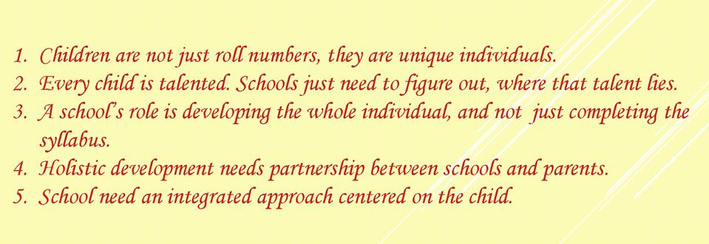
Our belief system
© Jindal Mount Litera Zee School, Sukeli.

Slide 6
Let’s Introduce
you to
the
Management Committee
© Jindal Mount Litera Zee School, Sukeli.

Slide 7
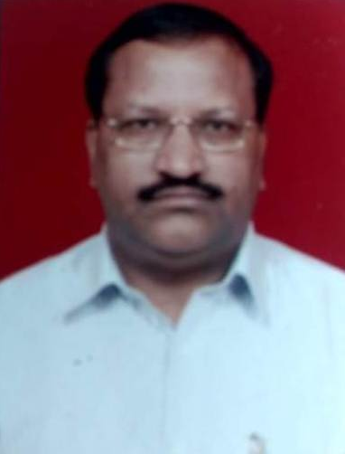
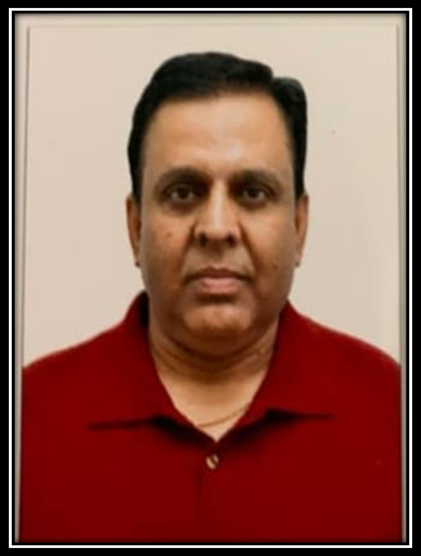
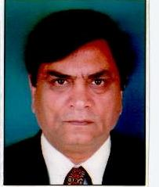
School Management committee members
Member
Mr. Shiv kumar Singhal
Member
Mr. Sanjeev BAnerjee
Chairman
Mr. Vijay Kaushik
© Jindal Mount Litera Zee School, Sukeli.
Notes:
Jinda

Slide 8
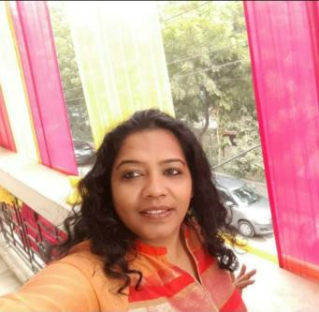
Our Mentor
Ms. – ANSHUL SAXENA
Regional School Director Zee Learn
E-mail :- anshu.saxena@zeelearn.com
Ph. No. :86577 35898
© Jindal Mount Litera Zee School, Sukeli.

Slide 9
PRINCIPAL
Ms - SAVITA SHARMA
PRINCIPAL
Ph. No. :7875092867
E-mail :-mlzsnagothane@gmail.com
© Jindal Mount Litera Zee School, Sukeli.

Slide 10
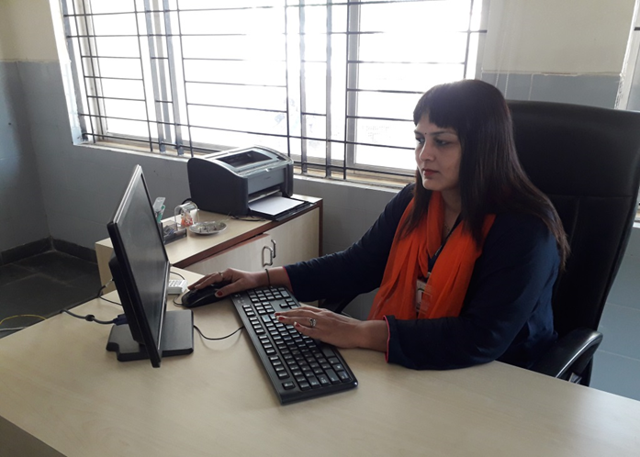
VICE PRINCIPAL
Ms– BIJAL AWASTHI
VICE PRINCIPAL
Ph. No. :90161 93906
E-mail :-vpjmlzs@gmail.com
© Jindal Mount Litera Zee School, Sukeli.

Slide 11
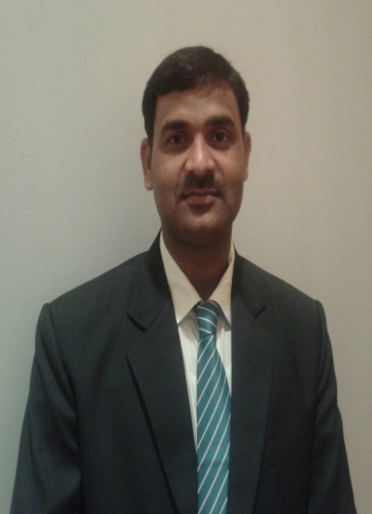
For your reference
MR. – AJAY YADAV
Admin Officer
Ph. No. :9422351104
E-mail :- yadavajay.jmlzs@gmail.com
© Jindal Mount Litera Zee School, Sukeli.

Slide 12
For your reference
MRS. VISHWAKALA NAIR
Relationship Manager
Ph. No. :8007077936
E-mail :- vsnair.jmlzs@gmail.com
© Jindal Mount Litera Zee School, Sukeli.

Slide 13
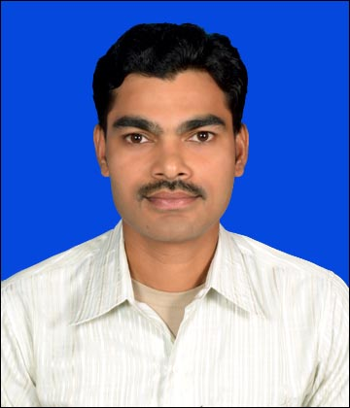
For your reference
MR. DEVENDRA KASHYAP
Accountant
Ph. No. :938395658
E-mail :- kashyap.jindal@gmail.com
© Jindal Mount Litera Zee School, Sukeli.

Slide 14
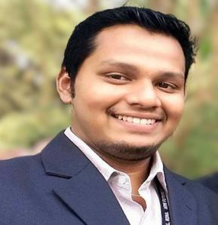
For your reference
MR. Pratik Palande
I. T. Head
Ph. No. :75584 98598
E-mail :- jmlzsit@gmail.com
© Jindal Mount Litera Zee School, Sukeli.

Slide 15
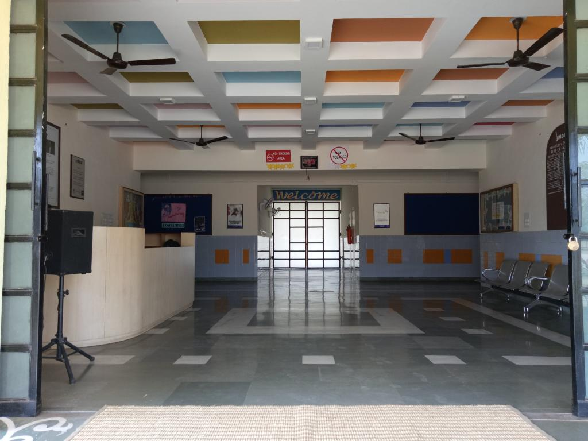
Competitive Exam In charge:-
Ms. Puja Esai- NSO, IMO,
Mr. Omkar Khonde:-Homi Bhabha, MTSE, NTSE
Mr. Avdhut Athavale- NCO

Slide 16
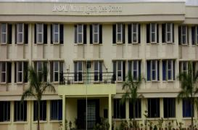
BIRTHDAY POLICY
(Primary section)
The Students can Bring Any Small Chocolate of Value Rs.1 or Rs.2.
No Birthday Parties Will Be Held In
School
No Birthday Gifts or Return Gifts Will Be
Exchanged With Students or Educators.
You can Send your child in party dress.
A small sapling can be planted by the child.

Slide 17
Health Issues
In some cases, if the medical attention is required
specially please keep the authorities of the school
informed at all times with doctor’s prescription
attached.
No student should attend school if he/she is
suffering with serious or contagious disease. They
will be allowed to attend the school again when a
medical certificate is produced.

Slide 18
Areas of observation
• Personal Hygiene
•General behavior of the students
•Discipline of the students
•Punctuality of the students
•Academic Records
•Active Participation of the students in different
activities
•Absenteeism
•Overall Personality Development

Slide 19
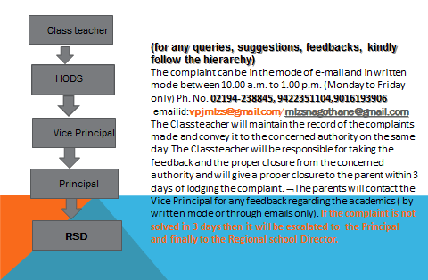
Hierarchy to be followed for giving
feedback/resolving grievance

Slide 20
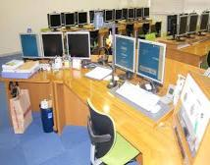
Specials In JMLZS
Library
Art room
Dance room
Computer room
Classrooms with IWB
Language Lab
Science Labs
Sport room
Math Lab
Ground
Auditorium
Conference room

Slide 21
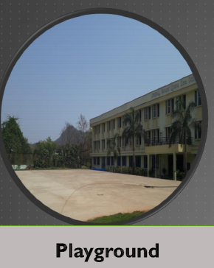
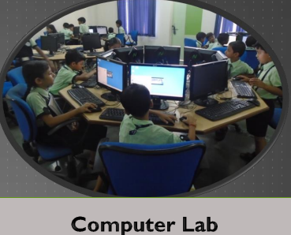
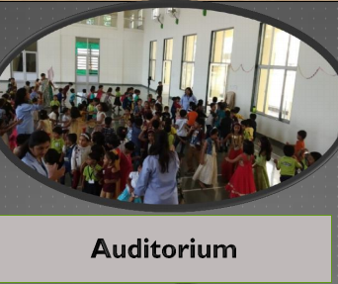
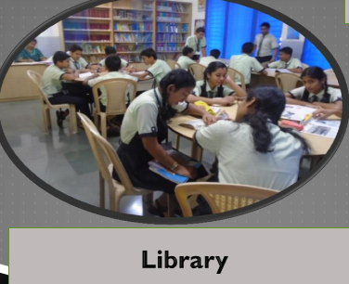
School Infrastructure

Slide 22
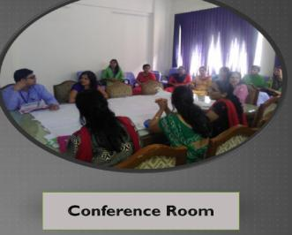
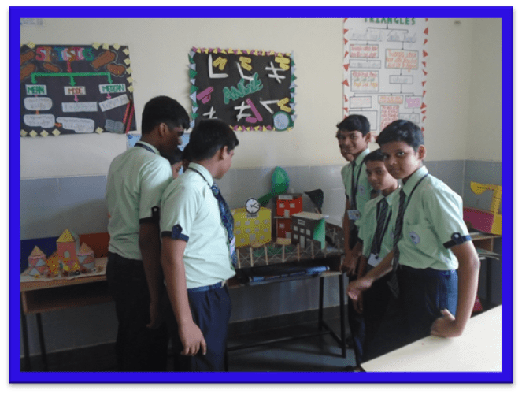
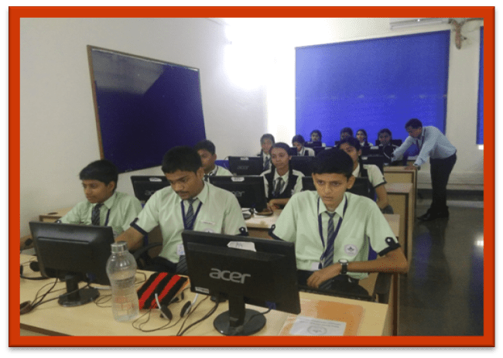
School Infrastructure
Math lab
Language lab

Slide 23
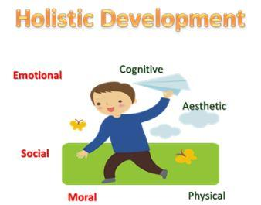
Parents On Campus policy
We strongly believe that Holistic Development of students is based on 4 pillars Student, Parent, Teacher and School.
To further strengthen the bond of all stake holders, we hereby, introduce the “Parent On Campus” policy.
In short, Everyday one parent present in the school campus before the start of the school till the end of the school.
This will not only enhance the trust between parents and school but will prove to be an important step towards fostering a relationship of confidence.
This is an effort to supplement and re-enforce our commitment to provide Safe and Secure Environment and to make parents as Partners in our endeavor of imparting Holistic Quality Education.
© Jindal Mount Litera Zee School, Sukeli.

Slide 24
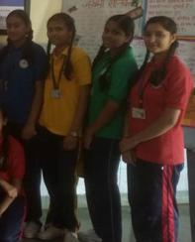
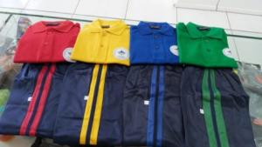
School uniform
Girls’ skirt should be up to knee length.
Boys’ shirt is required to be tucked into the pants at all times.
Girls’ shirt are to be as prescribed in the Dress Code and should be worn, extending at least 6” below the waist.
Sports uniform to be worn by all students on every Wednesday and Friday.

Slide 25
School timings for students
Reporting Time:9:00 a.m. sharp.
Dispersal Time:2:10p.m. sharp.
Every 2nd and 4th Saturdays are working for all students attending school is mandatory.

Slide 26
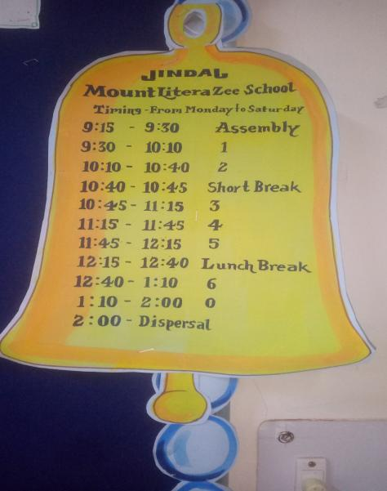
Bell Timing
For offline school timings

Slide 27
Our consultation Timings
Time to meet Principal : 2:00 p.m. to 5:00 p.m. (Monday - Friday)
(with prior appointments only)
Time to meet Vice Principal :2:00 p.m. to 5:00 p.m. (Monday - Friday)
(with prior appointments only)
Time to meet Teachers :01:30 p.m. to 2:30 p.m.
(with prior appointments only)
Office timings : 09:00 a.m. to 05:00 p.m. (Monday to Friday)
: 9.30 a.m. to 3.30 p.m. (Saturday)
Note:(meeting with prior appointments only, Appointments can be taken through a note in almanac or by a phone call to principal or vice principal)

Slide 28
Transport Policy
Student should arrive at assigned bus stop five minutes ahead of the bus. The driver cannot wait for you, as it may create traffic problems.
The bus attendant has the authority to assign seats.
Parents are not allowed to interfere about their children's seats because teachers have given the right to arrange children's sitting and they can rotate kids on a monthly or weekly basis.
Students are required to ride their assigned bus, unless they have written approval from the transport department.
In some cases if parents come & pickup their kid then prior notice must be given to teacher regarding the take away.
If your are a walker & because of some reason if you cannot come to school for takeaway your kid than you must handover written letter to the person whom you trust and want to handover your kid. Otherwise we will not allowed your kid to go with any one if you call us and insist us.
Refrain from talking to the driver expect in an emergency.
Parents should also support policies of the school and transport department.
Students are not allowed to eat in bus as it can harm them while travelling eating is dangerous.
© Jindal Mount Litera Zee School, Sukeli.

Slide 29
BUS ROUTE
Student will come to know about their bus routes by the admin and a hard copy of the same will be put on soft board in each class by class teacher.
Bus NO. | Route Name | Registration No. | Driver and helper name
1,2,3 | MSL, Nagothane, Pali | MH 06 S 9499 MH 06 S 9609, MH 06 BP 8999, | Mr. Rajendra Rai, Mr. S Prajapati, Mr. Rakesh Jadhav
4 | ROHA | MH 06 S 8999 | Mr. Sheshrao Kakde(Driver)
5 | KOLAD | MH 06 S 9072 | Mr. Nilesh Chingade(Driver) and Ms. Nikita Chingde
6 | LONERE | MH 06 S 7858 | Mr. Baliram Kattav(Driver) and Mr. Siddhesh Pawar
7 | INDAPUR | MH 04 SK 2055 | Mr. Nandakumar Vani(Driver)
8 | VILE | MH 06 BP 8889 | Mr. Amar Salunke(Driver) and Ms. Vishakha Vani

Slide 30
Monthly Assembly Themes for 2021-22
April – READING
June - READING
July - ACCEPTANCE
August - ACCEPTANCE
September - SHARING
October – SHARING
November - DCP
December - DCP
January - TRANQUALITY
February - TRANQUALITY

Slide 31
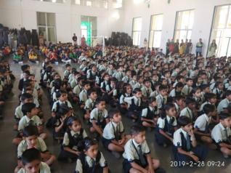
Assembly Time & Days
Students arrival: 9:10 a.m.
Assembly warning bell: 9:15 a.m.
Objective :
1.To inculcate ethical values and discipline among the students.
2.To sensitize the students with social and emotional learning skills.
3.To start school on harmonious note.
4.To boost or enhance the confidence in public speaking and also to reduce the stage fear among the students
Days: Three Days a week.(Thursday, Friday and Saturdays)
Mass P T: Every Wednesday for grade 1 to 5

Slide 32
Flow of assembly

Slide 33
Flow of assembly

Slide 34
JINDAL MOUNT LITERA ZEE SCHOOL
Primary
Time- Table

Slide 35
JINDAL MOUNT LITERA ZEE SCHOOL
Primary
Time- Table for lr and notebooks
GRADE 1TO 8 MATH TEXTBOOK CAN BE USED AS REFERENCE BOOK AND LR WILL BE USED AS A RESOURCE BOOK

Slide 36
SCHOLASTIC subjects
English
Mathematics
EVS
Hindi
General Knowledge ( G. K.)
Computer
Third language Marathi

Slide 37
Co-scholastic activities
Students are expected to participate in all school activities unless excused by the appropriate head on a written request from the parent / guardian.
Activities are as follows:
Clubs
Monthly theme based activity
Art & craft
Music
Dance
Sports

Slide 38
CELEBRATIONS for 2021-22
INTERNATIONAL EARTHDAY
WORLDBOOK DAY,ENGLISHLANGUAGE DAY
WORLD DANCE DAY
WORLD POPULATION DAY
INDEPENDENCE DAY
NATIONAL SPORTS DAY
TEACHERS DAY
HINDI DIWAS
NAVRATRI CELEBRATION
ANNUAL SPORTS DAY
CHILDREN’S DAY
INTERNATIONAL DAY FOR TOLERANCE
UNIVERSAL CHILDREN’S DAY
INTERNATIONAL HUMAN RIGHTS DAY
ANNUAL DAY
NATIONAL GIRL CHILD DAY
REPUBLIC DAY
BASANT BANCHAMI

Slide 39
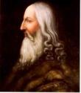
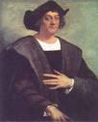
HOUSES
There are 4 houses in JMLZS
LDV: Leonardo da Vinci ( Red house)
MG: Mahatma Gandhi ( Green house)
CC: Christopher Columbus ( Blue house)
AE: Albert Einstein ( Yellow house)

Slide 40
HOUSE INCHARGES
LDV:( Red house) Mr.
MG:( Green house) Mr.Omkar Khonde
CC: ( Blue house) Ms.
AE: ( Yellow house) Ms. Manisha Dubey

Slide 41
Clubs
Sr.No. | Club Name | Club Incharge
1 | Art Club | Mr. Ganesh Rane
2 | Music Club | Mr. Pratik Nikam
3 | Mun Club | Mr. Lavkesh Landage
4 | English Literary Club | Ms. Rashmi Saxena
5 | Eco Club | Ms. Rutuja Zolage
6 | Heritage Club | Mr. Gajanan Awasarmol & Ms. Shreya Khot
7 | Raigad Club | Mr. Dhananjay Mahadik
8 | Math Club | Ms. Kavita Deshmukh
Club plans are available on our website for your reference

Slide 42
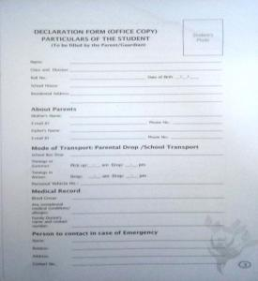
Important Pages In The Almanac
❖ Leave notes are must after resuming school in case of absenteeism.
❖ Kindly fill Page 1 to 4 given in the almanac. Submit to your class teachers by 20th June
❖ Parents are expected to attend the seminars & other activities arranged by
the school

Slide 43
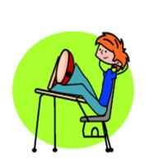
Values Taught in JMLZS
Notes:
Parents need to call the office several days before a student is to be taken out of our system in order for teacher and office staff to compete all of his or her records.
All fees and money owed for damaged or lost books need to be turned in prior to the student leaving JMLZS,

Slide 44
MEASURABLE Quality Objectives
60%of students to achieve 70% and more marks in all subjects.
100%results in class X And XII.
100% teachers to need to apply for CPD and implement the same in the classroom teaching.
100% of students to participate in all the intra school activities.
50% of students to show confident in public speaking/reasoning skills through club activities.
Out of 50 at least 10 students will achieve 90% and above in present Xth class.
Out of 8 at least 3 students in XII class to achieve 80% and above.

Slide 45
Measurable quality objective goal2021-22

Slide 46
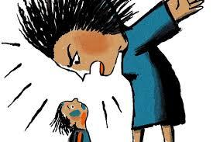
I-CARE
If you find bullying please contact vice principal and principal

Slide 47
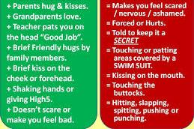
i- care
SAFE AND UNSAFE TOUCH
The school will not tolerate inappropriate behaviour by students such as bullying or ragging of any kind, overt display of affection between students, theft, forgery, borrowing without permission of the owner, improper care of the property of others and using obscene or vulgar language.

Slide 49
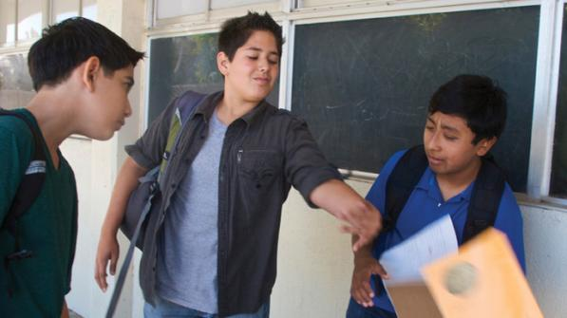
Bullying
Physical Bullying
Wrong Names

Slide 50
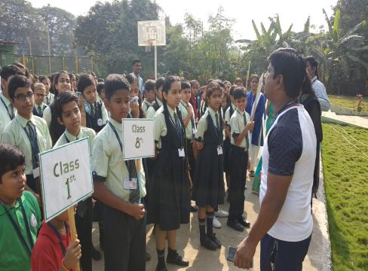
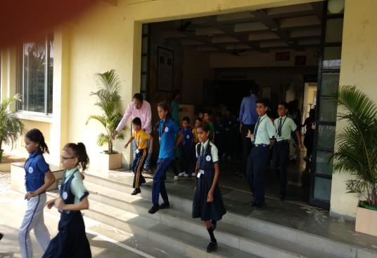
Evacuation Drill (Evacuation Plan)
3 Times in a year

Slide 51
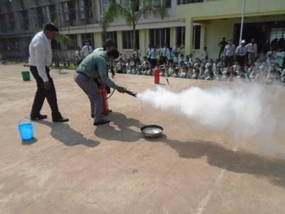
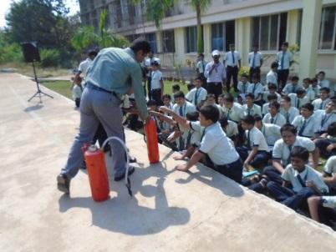
Fire Safety Drill

Slide 52
Some incentives subject-wise
I am Jmlzs scientist
Batches will be provided for specific subject by HODS,PRINCIPAL AND VICE PRINCIPAL for motivation

Slide 53
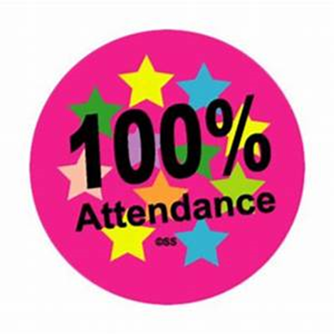
Some incentives subject-wise
Attendance
I am mathematician

Slide 54
WEBSITE AND EPLUS
Parents, guardians and students should check the school website and E-PLUS at regular intervals for updates.
New children can ask their class teachers to provide them their E-PLUS ,User ID and Password and same will be pinned on class soft board for reference

Slide 55
Education +
E-Plus is a School Management System which allows easy Interaction of Teachers with the Website. User id and password of the same will provided by 20th June to new students

Slide 56
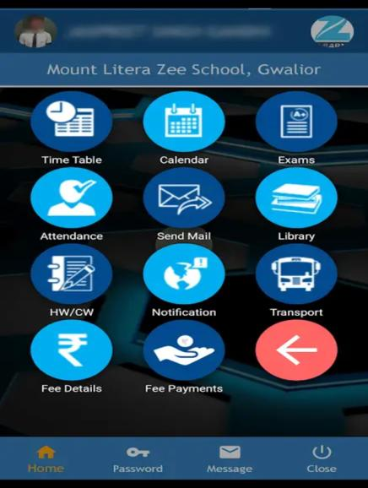
Education + APP AND WEBSITE
Login user id and password of the student has to be entered in the required fields to open on this education app. or on our school website to know more about school circulars, student details, school calendar which we upload on the app as well as website.

Slide 57
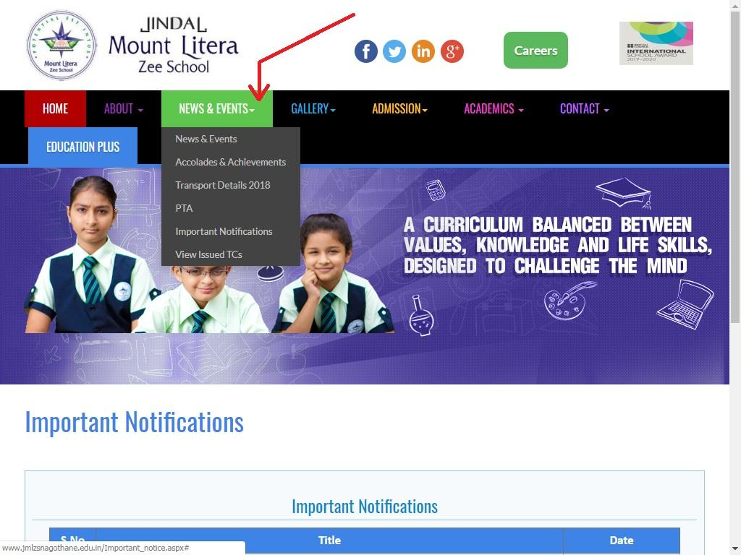

Slide 58
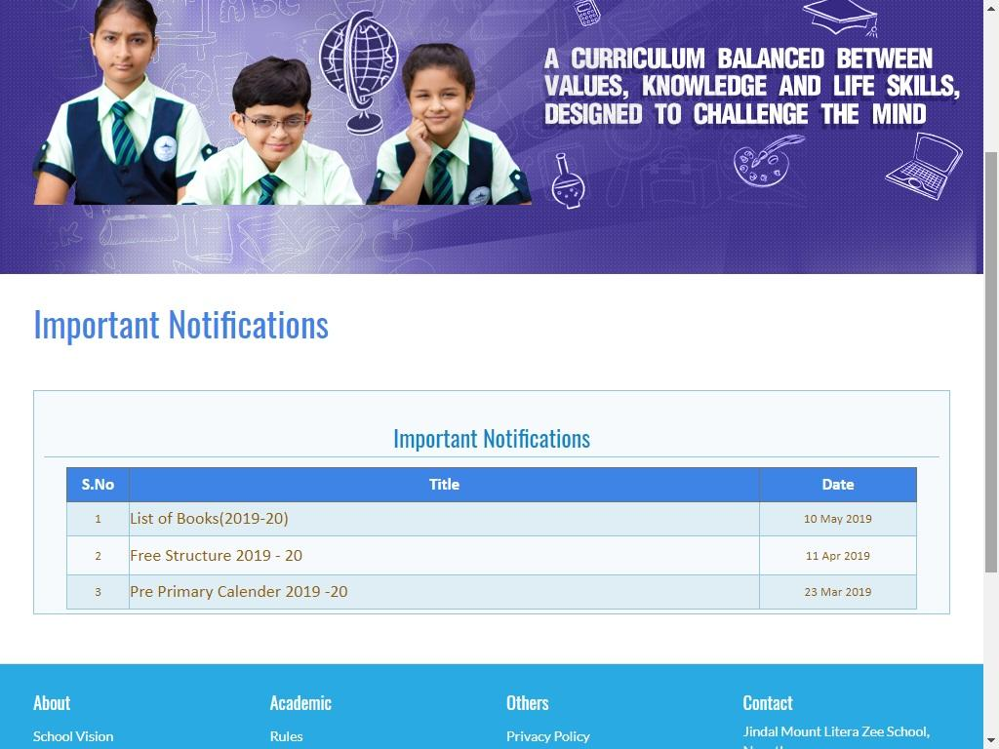

Slide 59
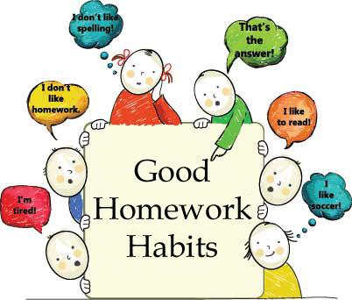
Home work and Assignments

Slide 60
Home work and Assignments
Homework teaches students about time management.
Homework teaches students how to set priorities.
Homework helps teachers determine how well the lessons and material are being understood by their students.
Homework teaches students how to problem solve.
Homework gives students another opportunity to review the class material.
Homework gives parents a chance to see what their child is learning in school.
Homework teaches students that they have to do things, even when they don’t want to.
Homework teaches students how to take responsibility
for their part in the educational process.
Homework teaches students how to work independently.
Homework teaches students the importance of planning,
staying organized and taking action.

Slide 61
Assessments FOR GRADE 1AND 2
Revision Days | Revision Days | Revision Days | Revision Days
20th June to 4th July | 6th sep to 20th sep | 25th Nov to 30th Nov | 21st April to 6th March
PT-1 | Half yearly | PT-2 | Yearly exam
5th July to 10 ^{th} July | 21st ^{th} Sep. to 18st Oct. | 1st Dec to 8th Dec | 7 ^{th} Mar to 16th Mar

Slide 62
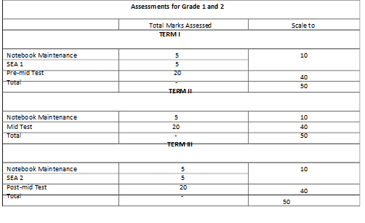
ASSESSMENT PATTERN

Slide 63
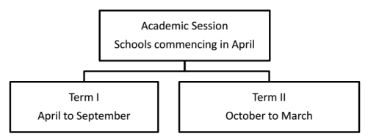
ASSESSMENT FOR GRADE 3TO 5
Revision Days | Revision Days | Revision Days | Revision Days
20th June to 4th July | 6th sep to 20th sep | 25th Nov to 30th Nov | 21st April to 6th March
PT-1 | Half yearly | PT-2 | Yearly exam
5th July to 10 ^{th} July | 21st ^{th} Sep. to 18st Oct. | 1st Dec to 8th Dec | 7th Mar to 16th Mar

Slide 64
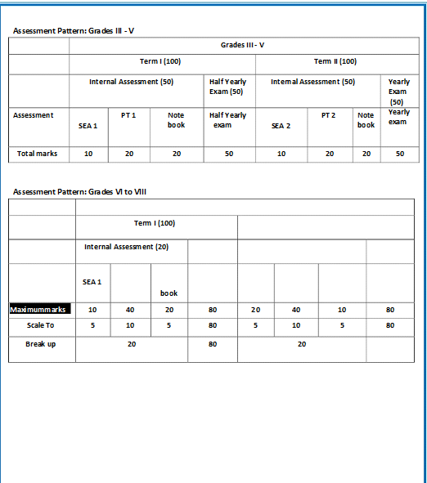

Slide 65
Whom to contact
Lost and found items are kept in the School’s Back Office. Any valuable item or cash found by students should be deposited at the Front Office. Students are advised to clearly write their name and class on all items brought to the school.
Email
mlzsnagothane@gmail.com
Phone
+91 9422351104

Slide 66
Break time
Short break for 5 minutes twice after every 2 periods.
Long break for 30 minutes. (After 4 periods)

Slide 67
food menu
In case your child is allergic to suggested menu, you can send suitable snack in their tiffin

Slide 68
To reduce bag weight JMLZ have special time tables for Notebooks & LRs

Slide 69
Bag weight/time table
All students are required to attend the school on all working days. Students must attend all classes as per school Time Table and bring with them all relevant books.

Slide 70
Make sure your child attends school
regularly and gets here on time.
Notes:
Make sure your child attends school regularly and gets here on time.

Slide 71
Parent Involvement
You are the key to your child’s success. Parents and teachers play an
active role in a child's
education…
Together,
we help them reach their full potential.

Slide 72
Parent Involvement Requirements
We ask that you guide and support your child’s learning by ensuring that he/she:
Attends school daily and arrives on
time, ready for the day’s learning
experience
Completes all homework assignments
given by teachers
Reads daily to develop a love for
reading and to improve literacy skills

Slide 73
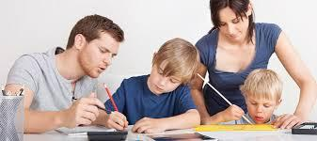
Shares school experiences with you so
that you are aware of his/her school life
Knows that you expect him/her to
succeed in school and give his best
Takes responsibility of his/her studies
Attends PTMs with your child.

Slide 74
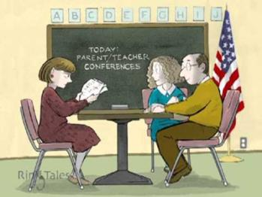
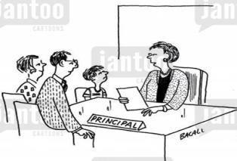
School- Parent Partnership
The PTA and the PTM
If you have expertise in a specific field, an unusual hobby, or have a different culture that you would like to share, please let us know.
If your child become discouraged or fearful about school, please communicate with us so that we can discover the cause of the problem.
Teacher Meeting Schedule- As per their convenience parents can meet any teacher after school hours. In PTM they can talk to the teachers.
Principal and vice Principal meeting schedule- Parents can meet at any time as per their convenience.

Slide 75
Activities undertaken by the school
International School Award
Digital Citizenship Program
Human Rights Education Club
Science/English/Math/cyber Olympiad Foundation

Slide 76
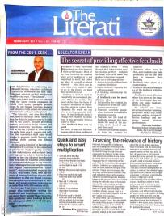
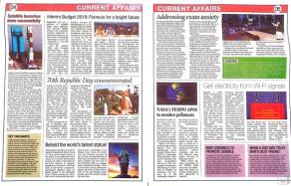
The literati
We are thrilled to announce the launch of ‘The Literati’, a monthly newsletter from Zee Learn Limited dedicated to sharing resources, practical advice and informed commentary on the latest Developments, Current Affairs, Sports, Knowledge Meter and Brain Teasers. It will spotlight the best practices and practitioners from across our network of MLZ Schools PAN India.
This newsletter aims to help our students develop a healthy and positive habit of reading in order to gain knowledge and information.
Happy Reading and oil your grey cells!

Slide 77
Academic Achievements

Slide 80
Parent Communication
Students Handbook / Almanac- will provide valuable information regarding School procedures.
Academic Calendar- will be uploaded on the school website or provided in paper format, to parents and will focus on information regarding your child’s upcoming activities & holidays.
Web Site http://www.jmlzsnagothane.edu.in/- The school website will have information regarding the and will be updated on a consistent basis.
https://www.facebook.com/jmlzsnagothane
E-mail:- mlzsnagothane@gmail.com
Phone calls:-02194-238845, 9422351104
Circulars:- Written circulars will be sent to the parents whenever required.
School management system:- It is available on school website.

